Slide 1
MOHAMMAD ASIF

Slide 2
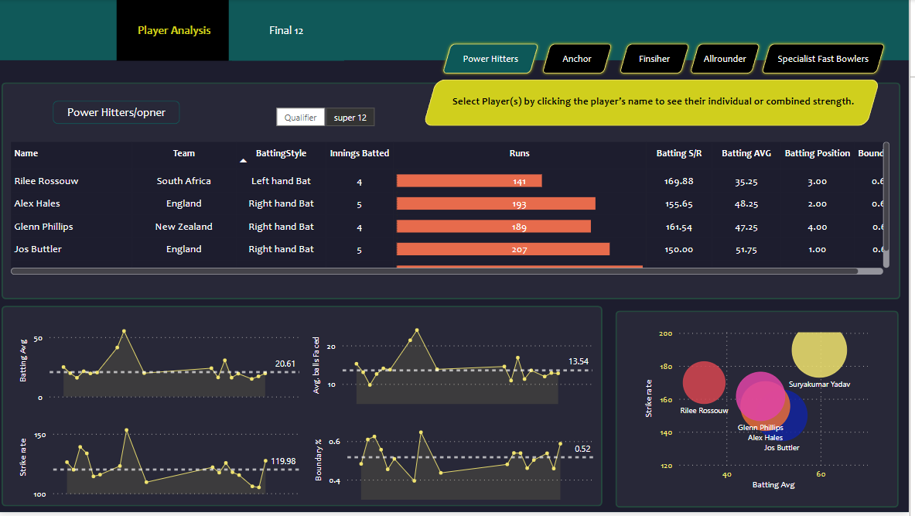
POWER HITTER

Slide 3
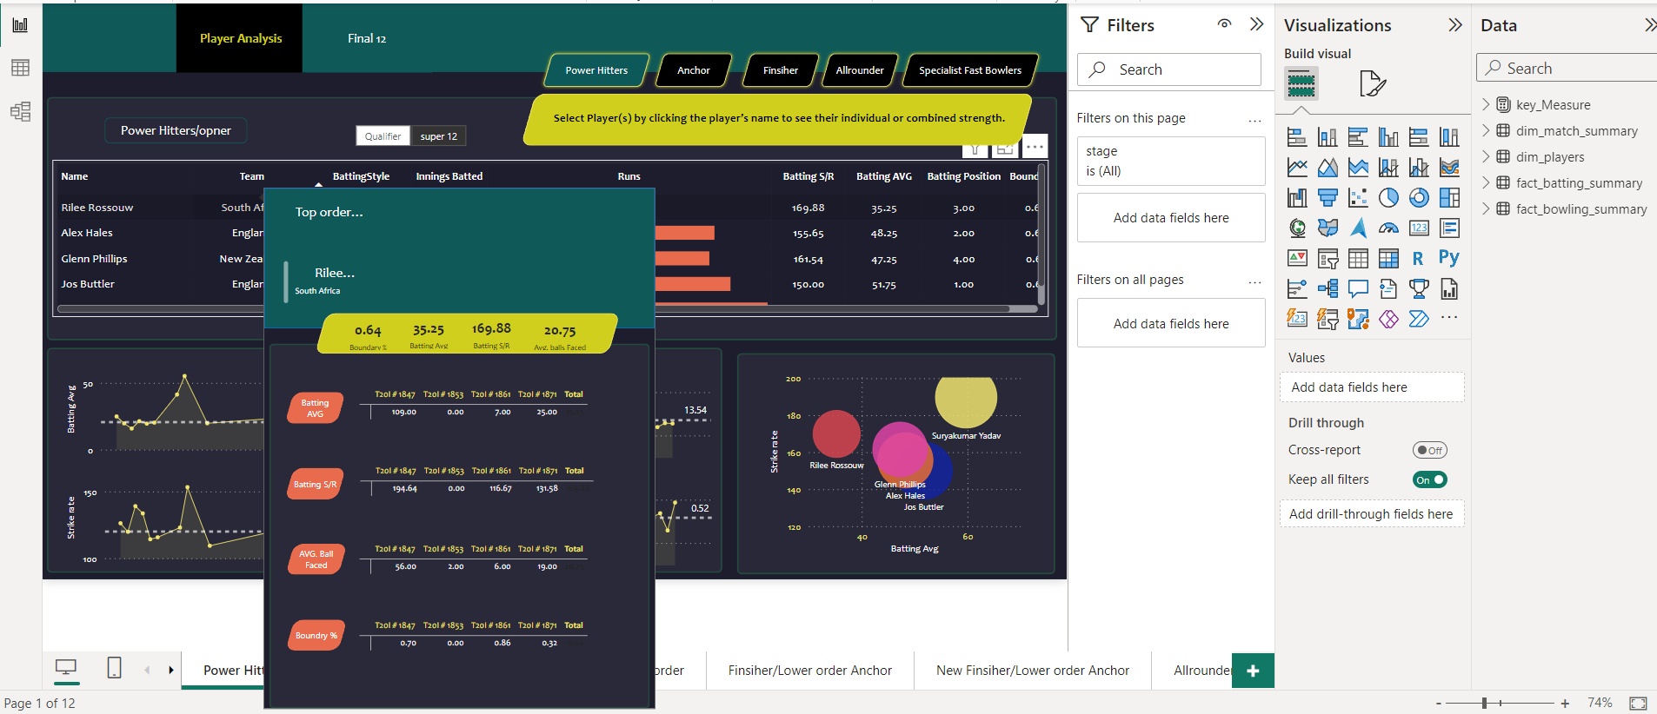
POWER HITTER/DETAIL

Slide 4
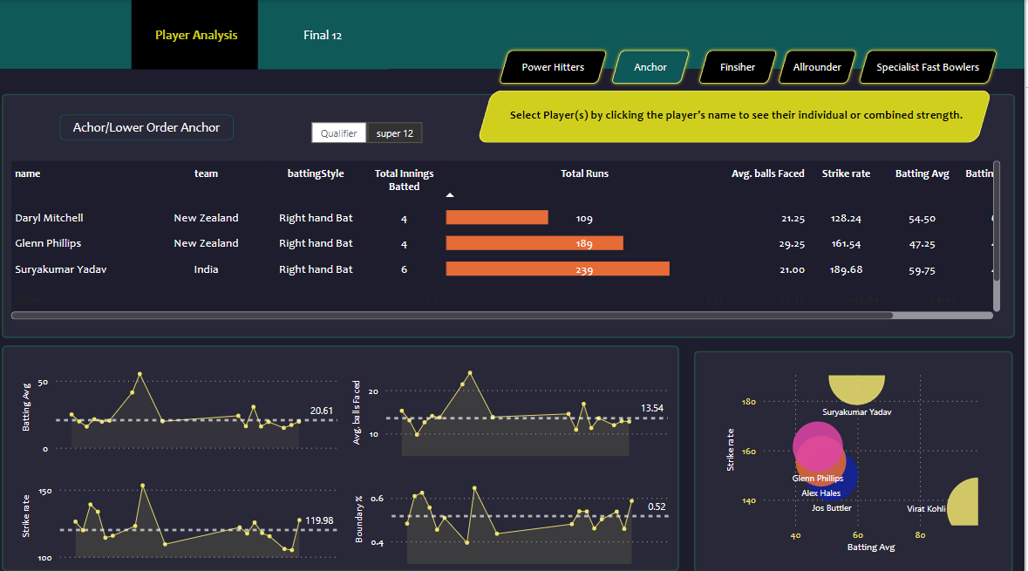
ANCHOR

Slide 5
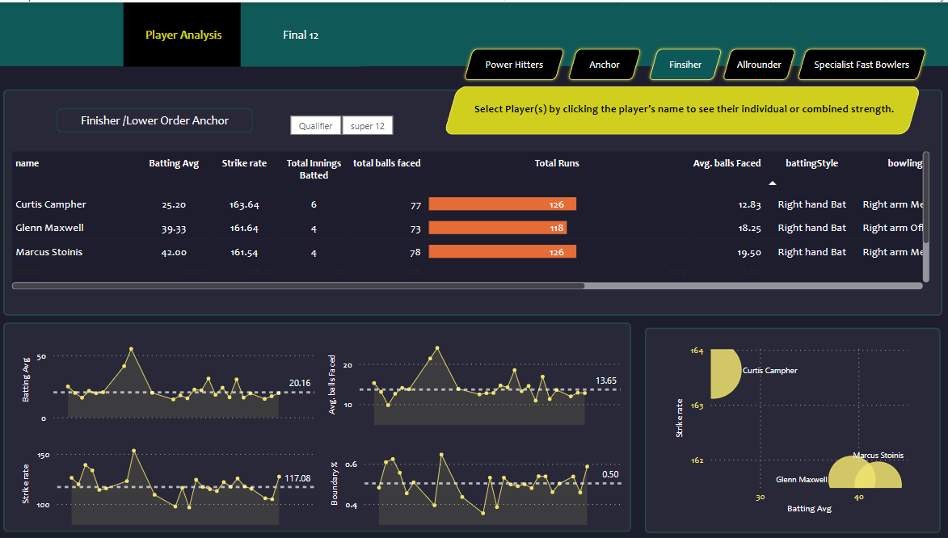
FINSIHER

Slide 6
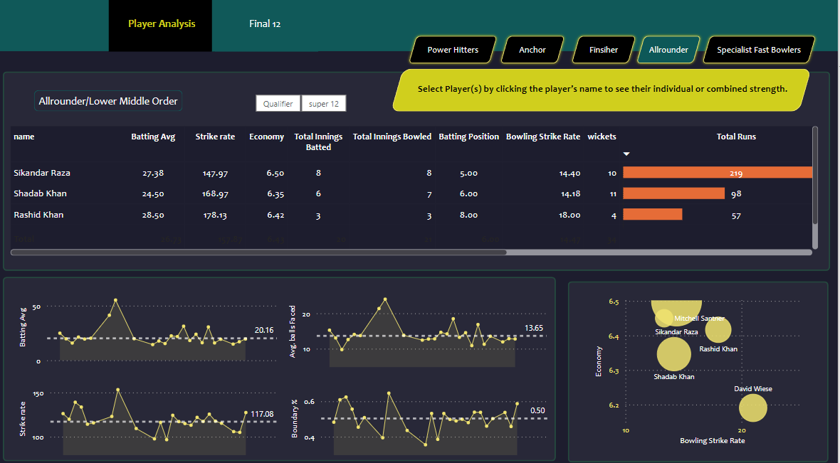
ALLROUNDER

Slide 7
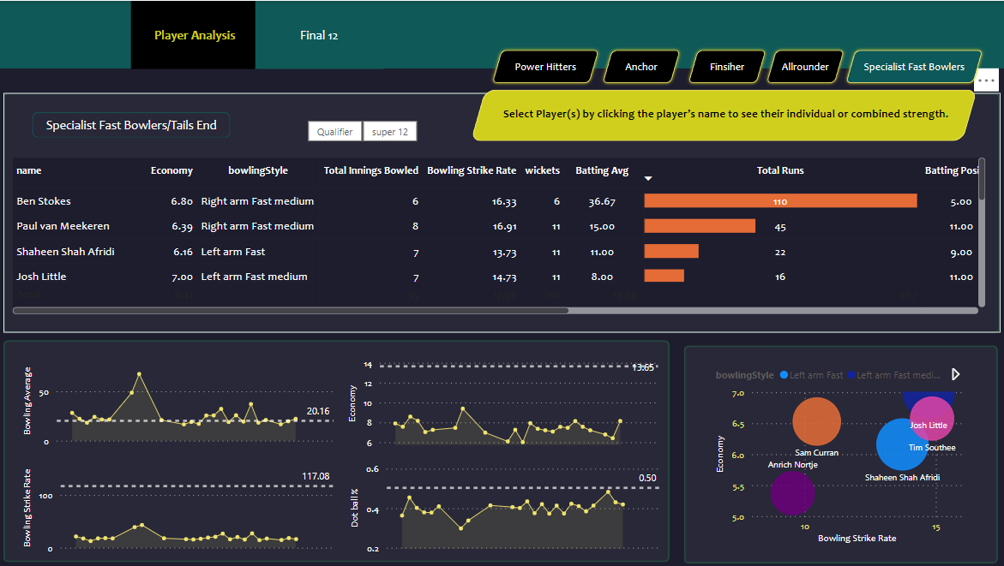
SPECIALIST FAST BOWLERS

Slide 8
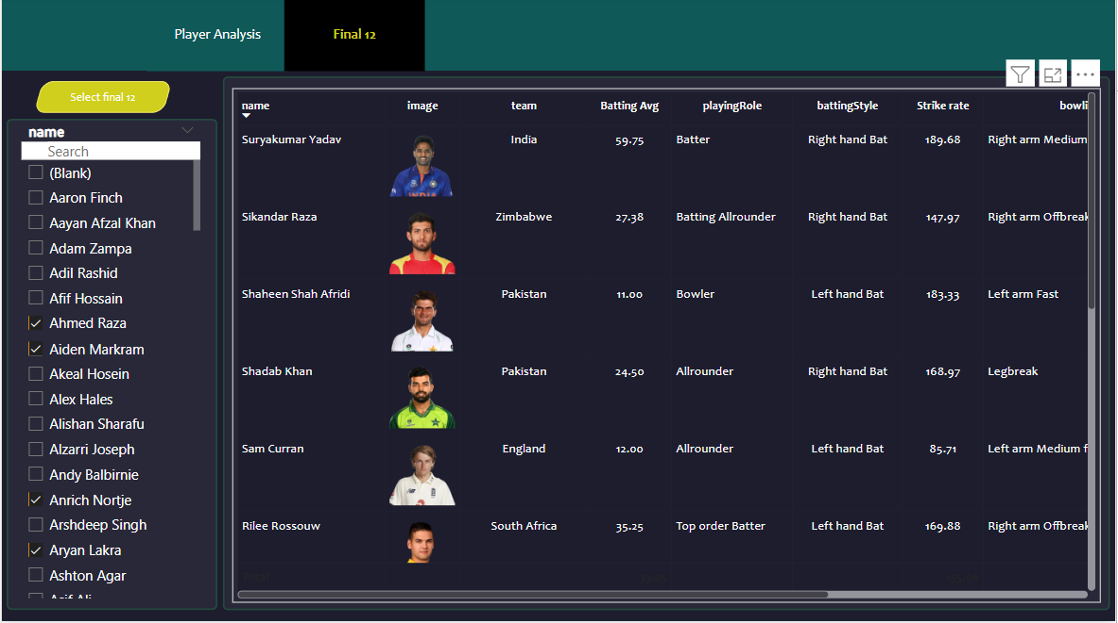
FINAL TEAM

